Slide 1

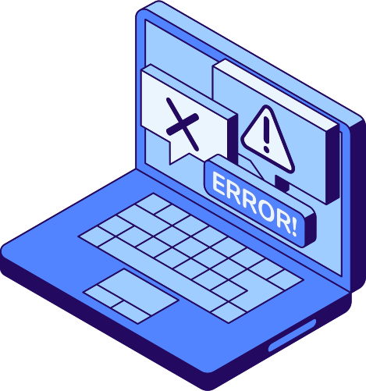
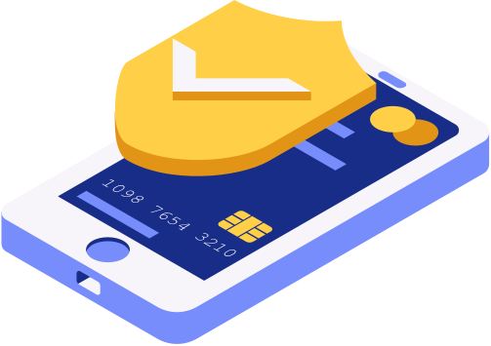

1
STRONG
PASSWORD CHECKER
&
A
UTHENTICATION
Shreya Dubey 241 & Tanuja Jadhav 231

Slide 2
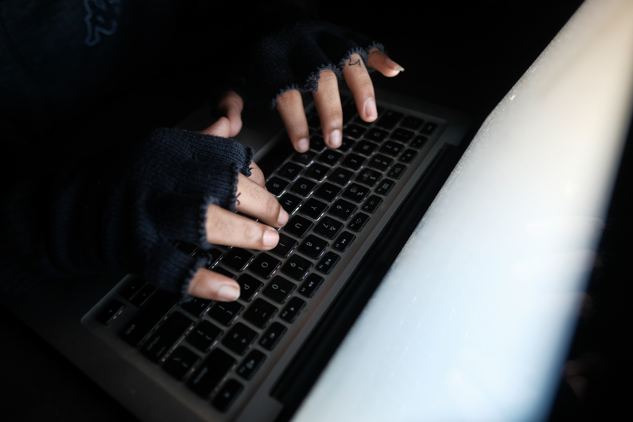
INTRODUCTION
2
STRONG PASSWORD CHECKER
A Strong Password Checker ensures users create secure passwords by enforcing important security rules.
It checks if the password has at least 8 characters and includes a mix of uppercase letters, lowercase letters, numbers, and special symbols. It also prevents the use of common or previously leaked passwords by checking databases .
The system blocks easy patterns such as "123456" or "qwerty," and avoids passwords containing personal information like names or birthdays.
As users type their password, the checker provides real-time feedback, helping them create stronger passwords.

Slide 3
INTRODUCTION
3
AUTHENTICATION
A Strong Password Checker ensures users create secure passwords by enforcing important security rules.
It checks if the password has at least 8 characters and includes a mix of uppercase letters, lowercase letters, numbers, and special symbols. It also prevents the use of common or previously leaked passwords by checking databases .
The system blocks easy patterns such as "123456" or "qwerty," and avoids passwords containing personal information like names or birthdays.
As users type their password, the checker provides real-time feedback, helping them create stronger passwords.

Slide 4

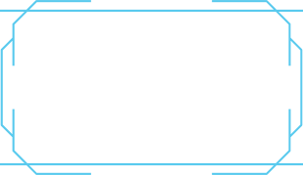

TOOLS
4
Programming Language & Framework
Python – Main language for backend logic.
Flask (or similar) – Lightweight web framework for routing and rendering.
SQLite – Lightweight, file-based database for storing user credentials.
HTML/CSS – Templates styled for usability and feedback.
Python libraries – unittest, hashlib, etc. for testing and security.

Slide 5
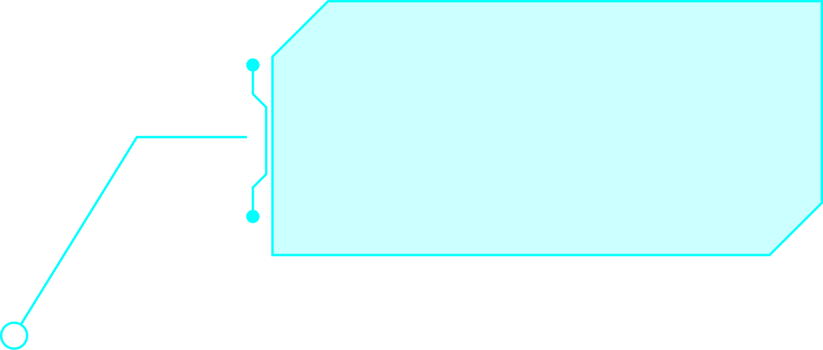
5
Password Strength Validation
Hashing Algorithms
Session Management
Database Protection
Testing & Validation
TECHNIQUES

Slide 6
6
Why is Security Important?
Protects Sensitive Data : Prevents unauthorized access to personal, financial, and confidential information.
Prevents Data Breaches : Stops attackers from stealing large amounts of user data, which can cause financial and reputational damage.
Prevents Account Takeovers : Strong security prevents attackers from guessing or cracking user passwords and taking over accounts.

Slide 7
7
Protects Privacy : Ensures user information (like names, email addresses, and passwords) remains private and safe.
Prevents Financial Loss : Data breaches and hacks can lead to huge fines, lawsuits, and financial loss for businesses.
Prepares for Future Threats : Ongoing security measures help protect against emerging cyber threats.

Slide 8
8
Strong Password Checker – How Does It Work?
User enters a password.
System checks:
•Is it long enough (12+ characters)?
•Does it contain uppercase, lowercase, numbers, symbols?
•Is it not a common password?
•Is it free of easy patterns (like "123456")?
Gives real-time feedback:
• Weak, Medium, Strong

Slide 9
9
Authentication – How Does It Work?
Registration:
•User enters username and password.
•Password is hashed (e.g., bcrypt).
•Hashing turns the password into a random string.
Example:
•Input: MySecret123!
•Hash: a1b2c3d4e5f6...

Slide 10
10
•Even if DB is hacked, attackers can't see the original password.
•Only the hashed password is stored in the database.
Login:
•User enters username and password.
•System compares hashed input with stored hash.
Session:
•On success, a secure token (like JWT) is given.
•Token is used for future requests.

Slide 11
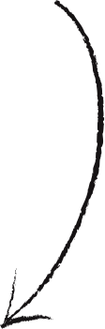
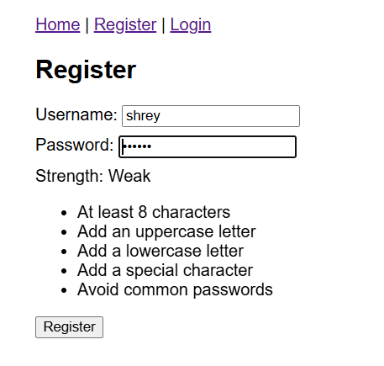
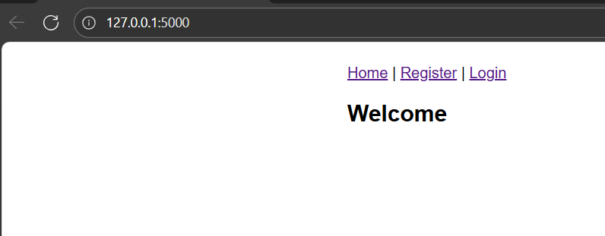
Demo
Username cannot be repeated

Slide 12
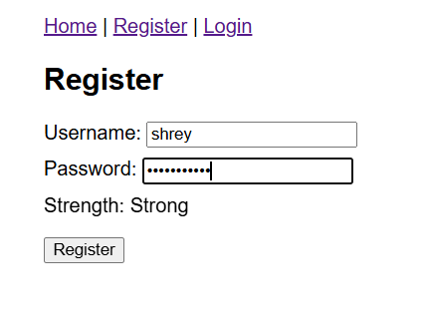
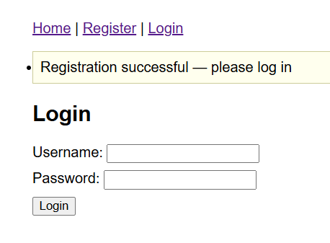
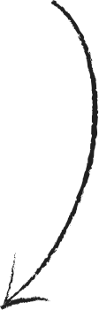

Slide 13
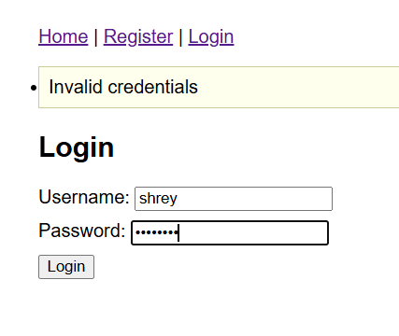
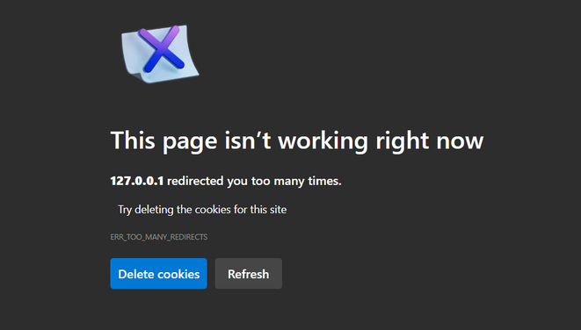

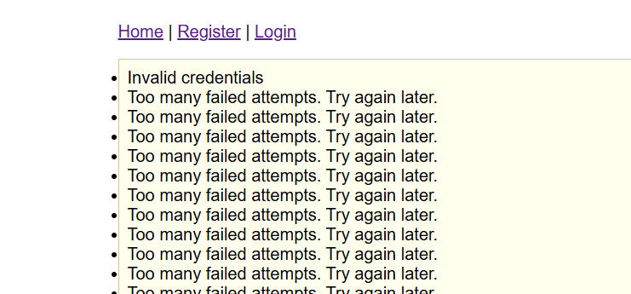
Invalid credentials
If the password is wrong
If the username is wrong
If the user is not registered
If someone tries to login multiple times with a registered username but wrong password , the page gets locked out

Slide 14
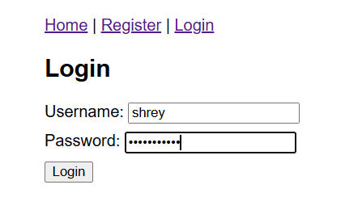
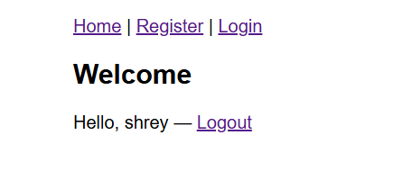
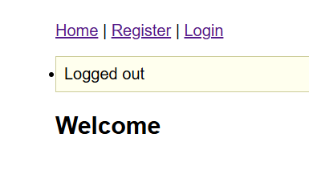

Slide 15
CONCLUSION
15
This project shows how simple security measures can prevent big risks.
Strong password +Secure authentication = better user protection

Slide 16
16
THANK
YOU!

